Slide 1

Social Network Community BCDE224 Assessment 2 Plan, design, test, code for the first iteration of a solution (a proof of concept).
By Gazelle Lowcay
Semester2, 2021

Slide 2


Chosen Feature: Adding new Post.
Add New Post

Slide 3
Task: Idea generation Phase
1. Wireframe for SOKOBUN Gaming Community
2. Wireframe for Hindi Language Learning Community.

Slide 4
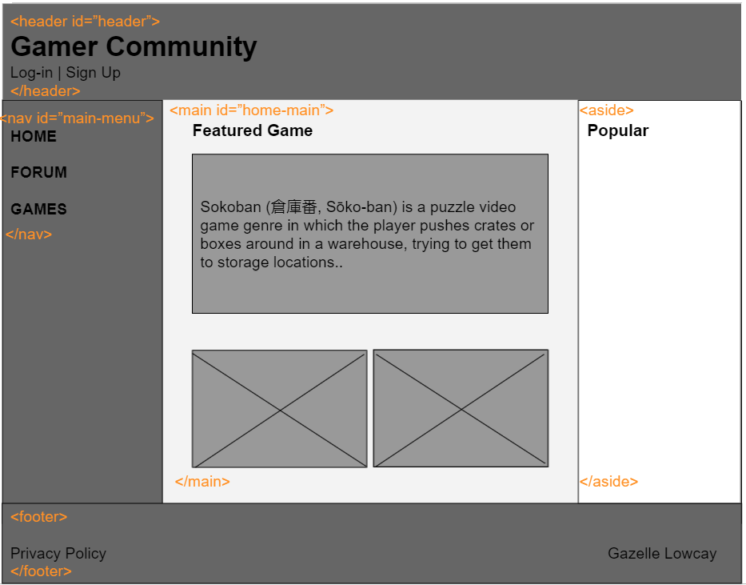
1. Gaming Community Wireframe(Home Page)

Slide 5
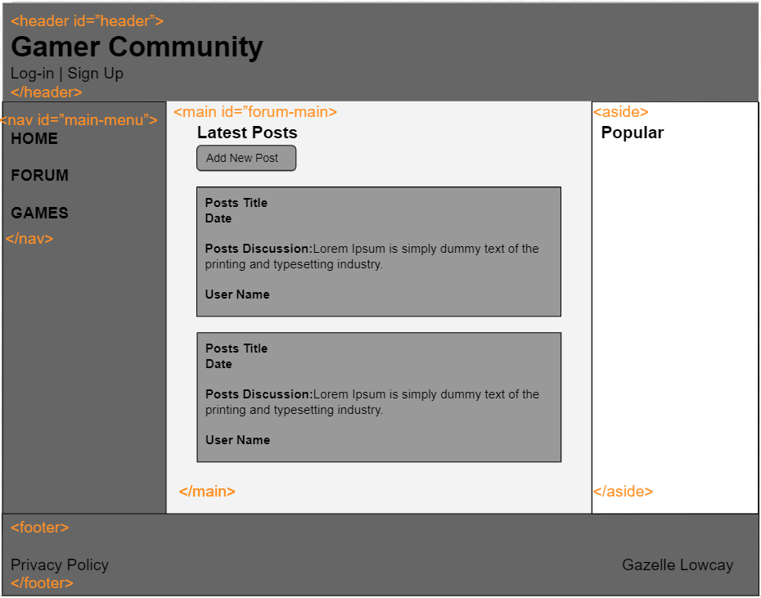
1. Gaming Community Wireframe(Forum Page)

Slide 6
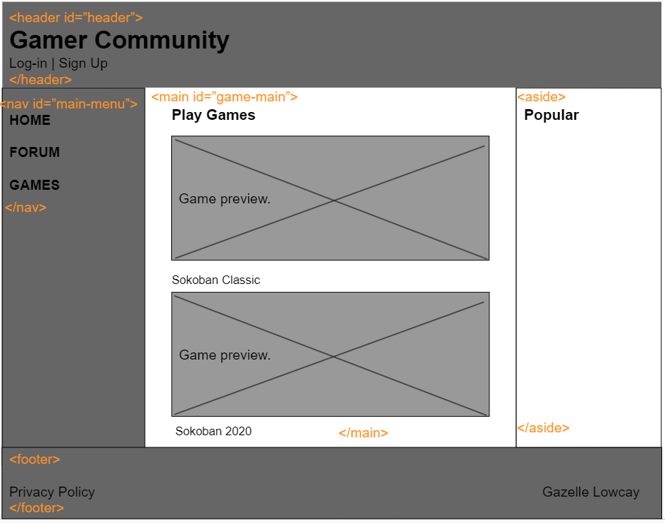
1. Gaming Community Wireframe(Games Page)

Slide 7
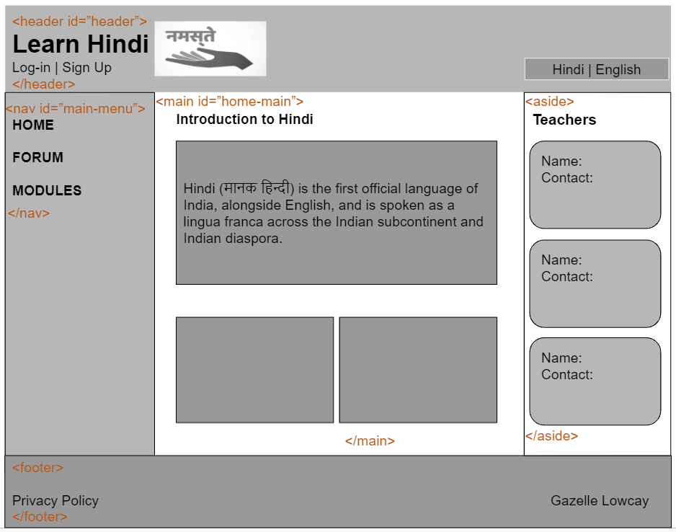
2. Hindi Language Learning Community (Home Page)

Slide 8
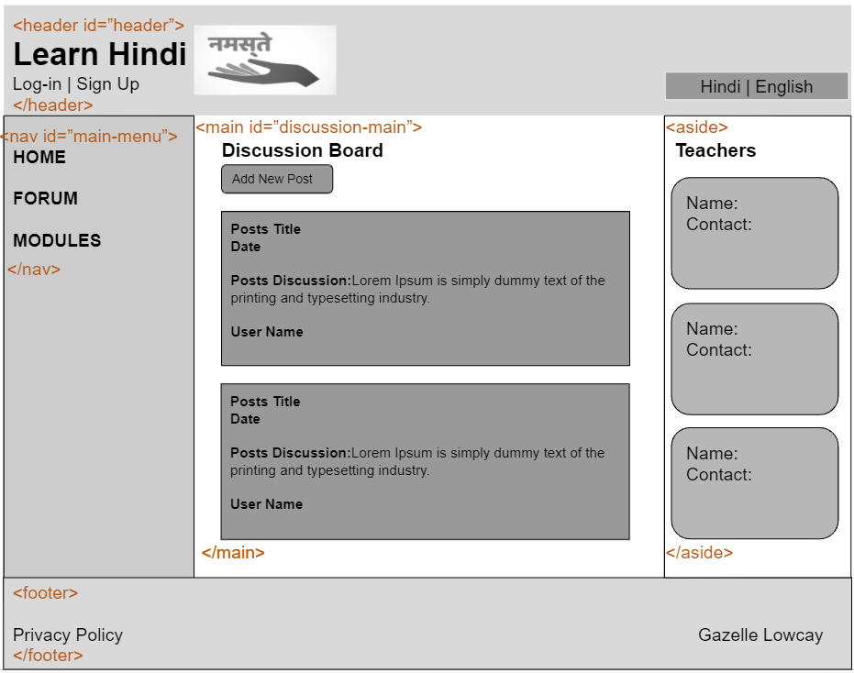
2. Hindi Language Learning Community (Forum Page)

Slide 9
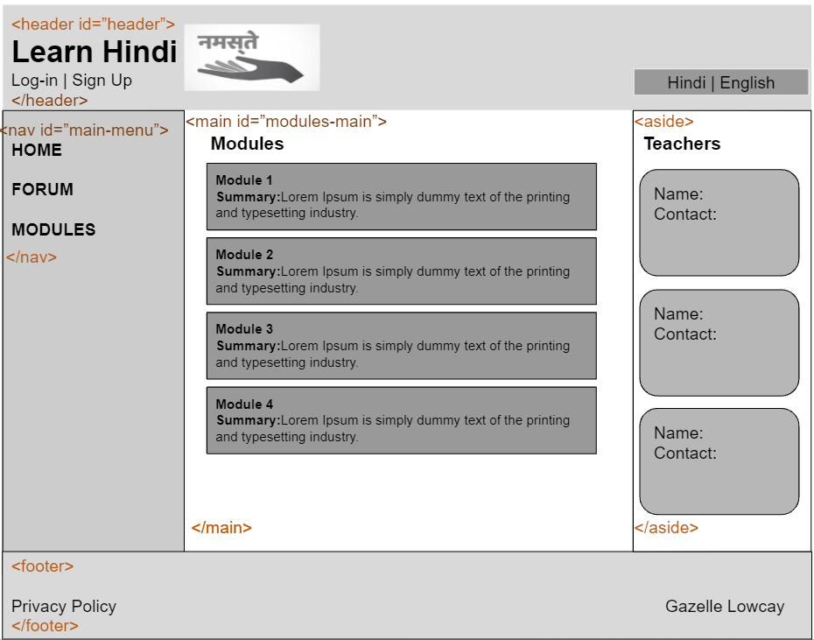
2. Hindi Language Learning Community (Modules Page)

Slide 10
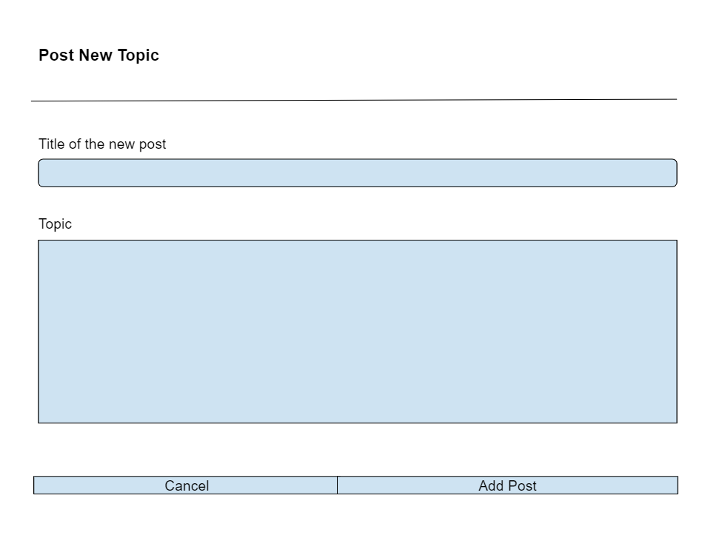
Add New Post Wireframe

Slide 11
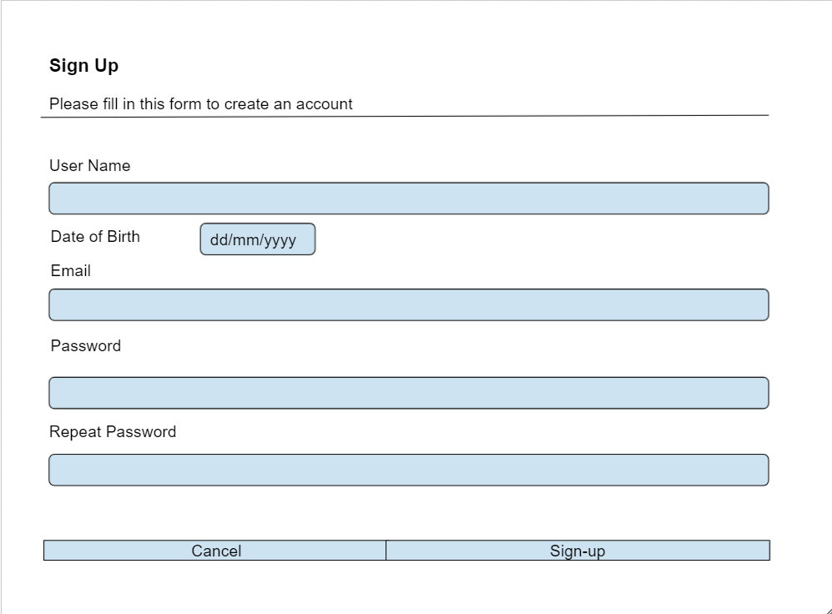
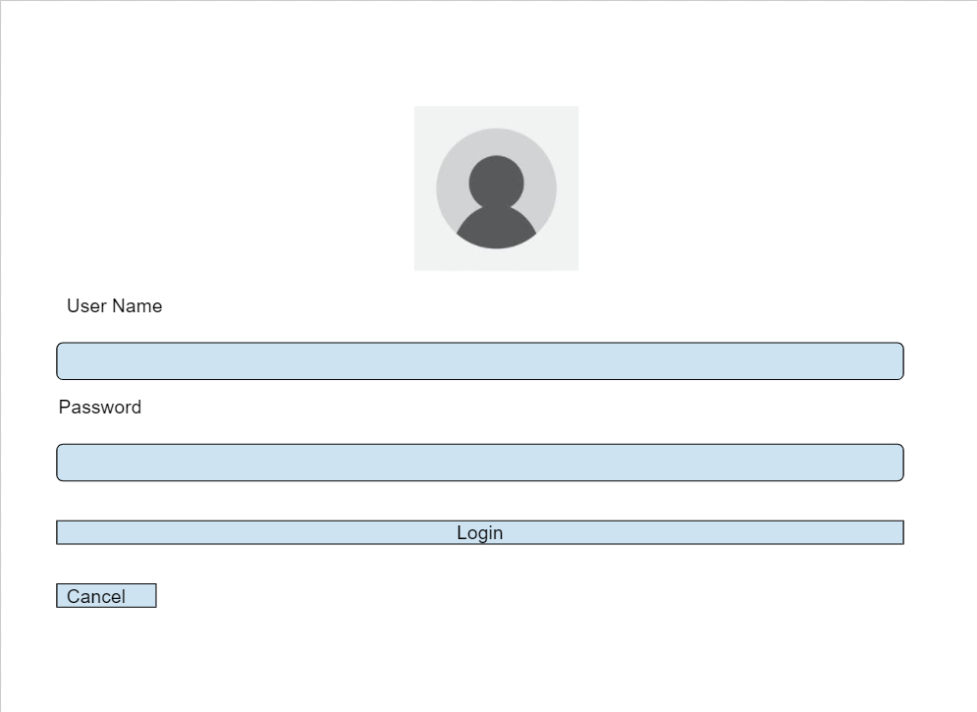
Sign-up Form Wireframe
Login Form Wireframe

Slide 12

Task: Behat FEATURE Requirements

Slide 13
1. Behat Feature Requirements
Feature: Add a new post in the forum
To add new posts
As a non-member visitor of the webpage, I need to sign-up for the social network membership.
Scenario1: As a non-member of the community, when I visit the webpage, I must be able to view the posts that other members have posted in the forum. I can also see the date it was posted and the username of the member who posted it.
Scenario2: As a non-member of the community, I must be able to filter all the posts based on the date that they were posted. I can also view all the comments under the posts.

Slide 14
2. Behat Feature Requirements
Feature: Add new post in the forum
To add new posts
As a logged-in member,
I need to go to the forum section and click the button, “Add New Post”.
Scenario1: As a logged-in member, I should be able to view posts that other members have posted in the forum. I can also add comments in their posts and join the forum discussion.
Scenario2: As a logged-in member, I can add new posts in the forum section. I can also view all my previous posts and edit or delete them. I can also comment or reply to comments on my own post.

Slide 15
3. Behat Feature Requirements
Feature: Add new post in the forum
To add new post
As a logged-in admin of the social network,
I need to go to the forum section and click the button “Add New Post”.
Scenario1: As a logged-in admin, I must be able to view all the posts and comments that other members have posted in the forum. I can also add posts and comments in the forum section. I can also delete posts that do not conform with the social network policy.
Scenario2: As a logged-in admin, I can delete, edit, update and add new content for the social network community.

Slide 16

Task: Mock (Hard-coded HTML) Forms

Slide 17
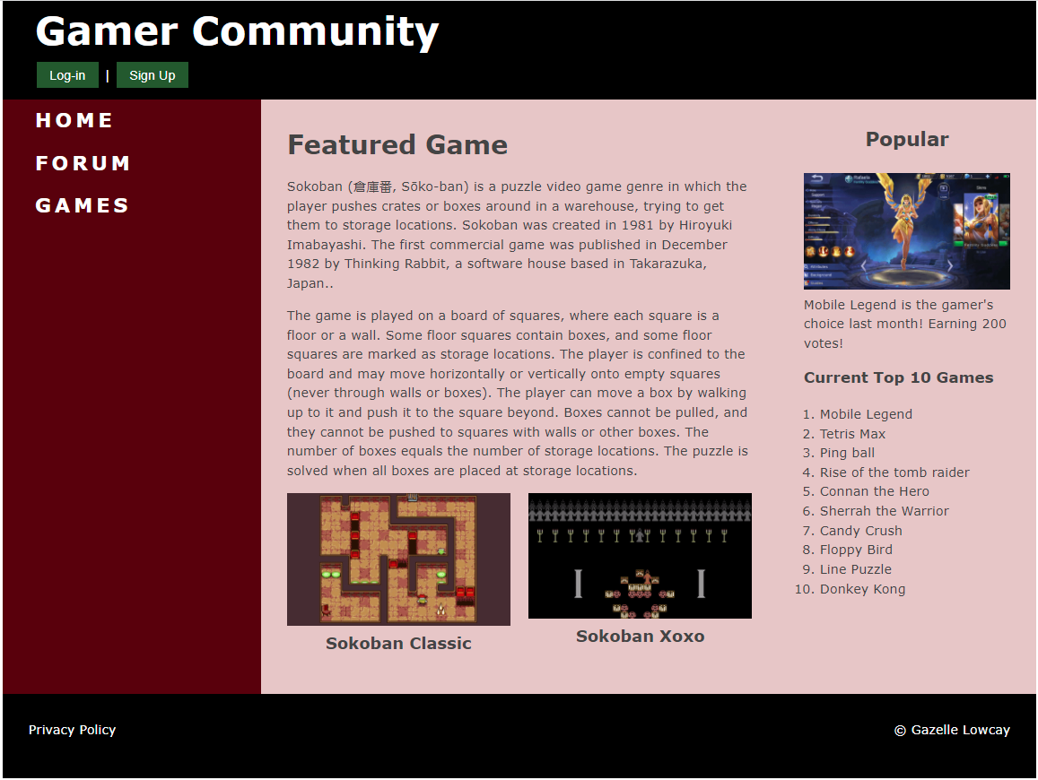
Game Community Home Page

Slide 18
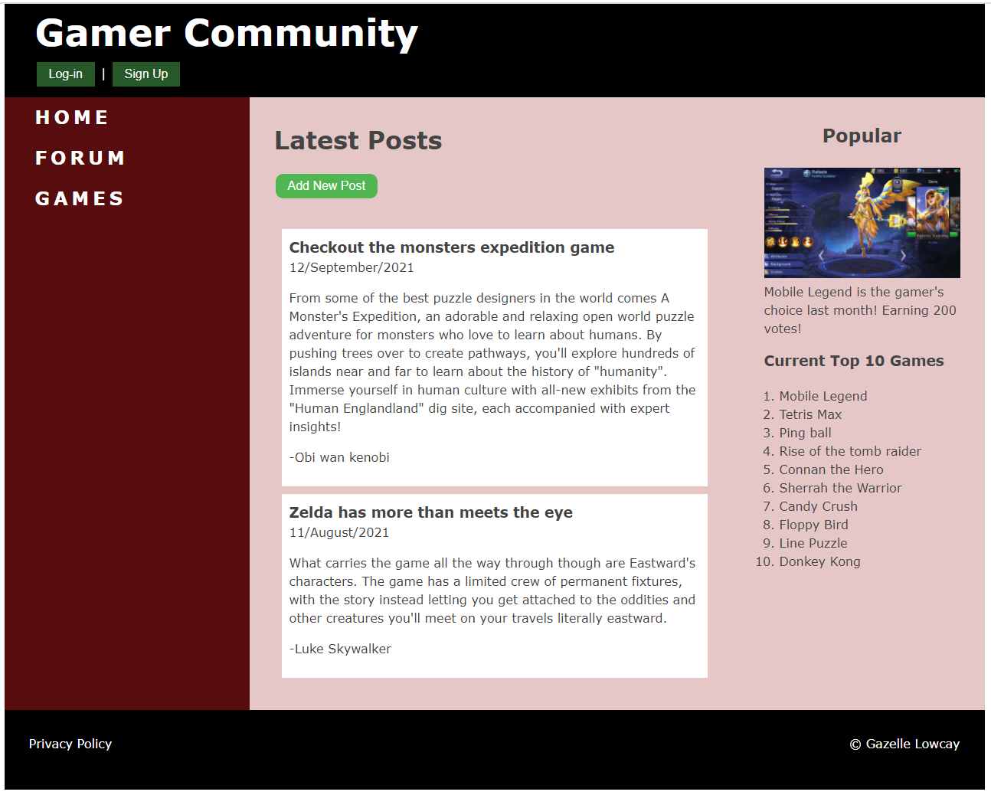
Game Community Forum Page

Slide 19
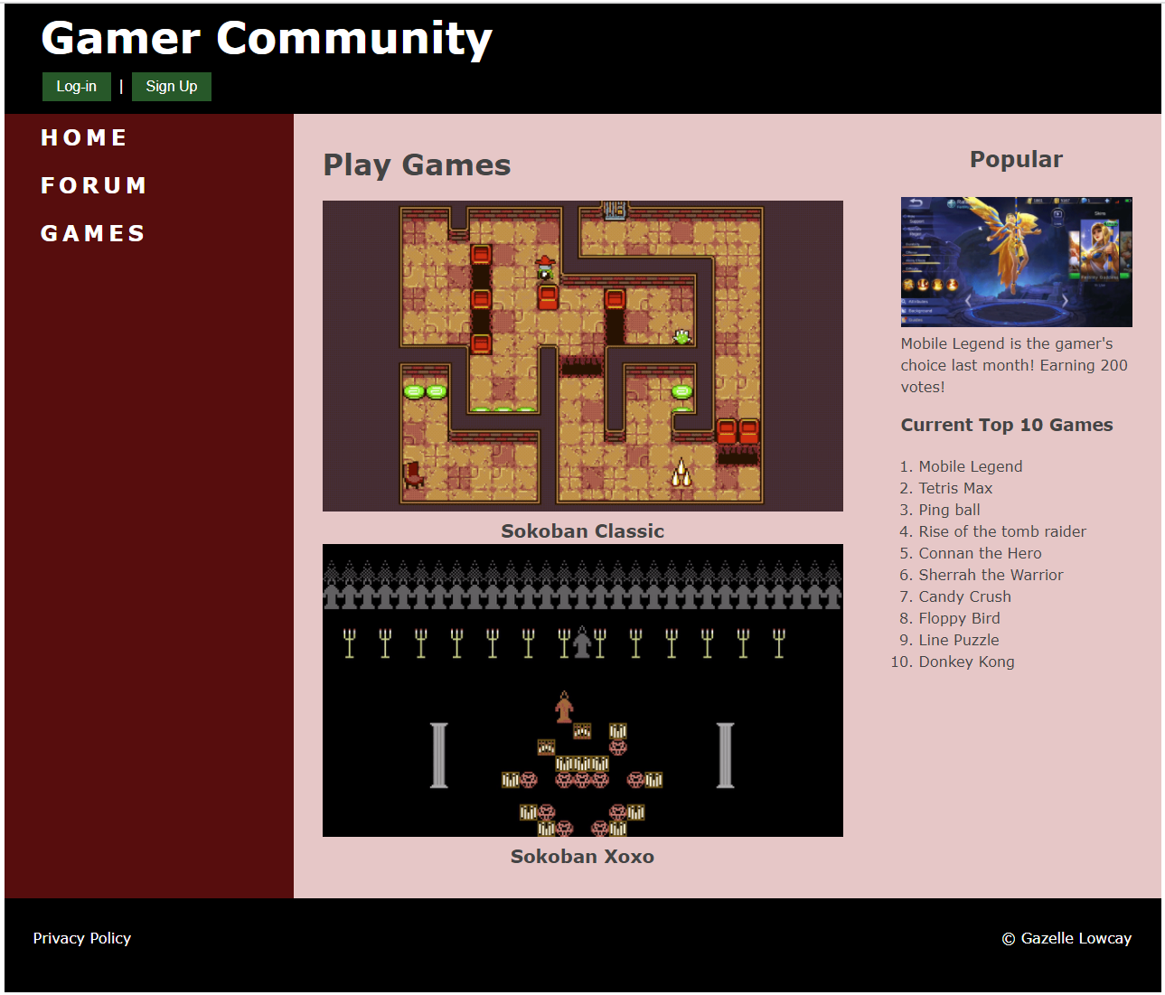
Game Community Home Page

Slide 20
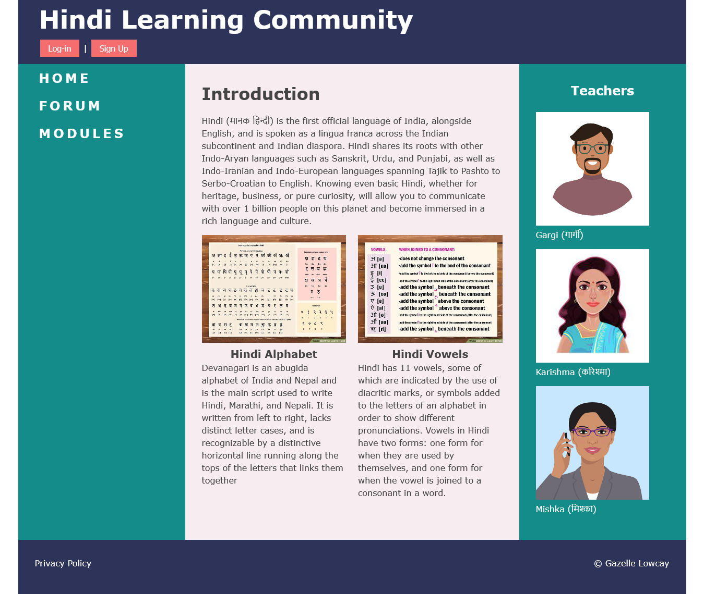
Learn Hindi Community Home Page

Slide 21
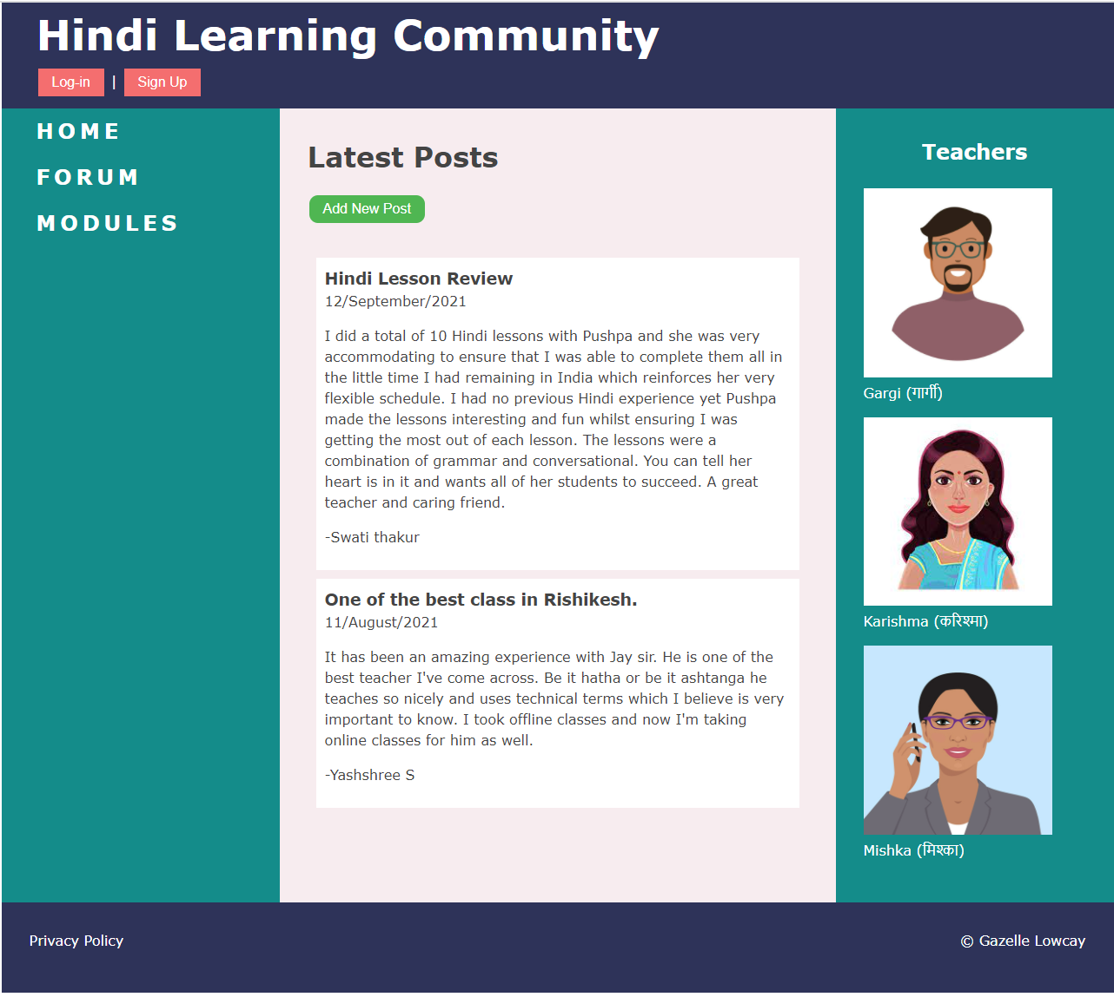
Learn Hindi Community Home Page

Slide 22
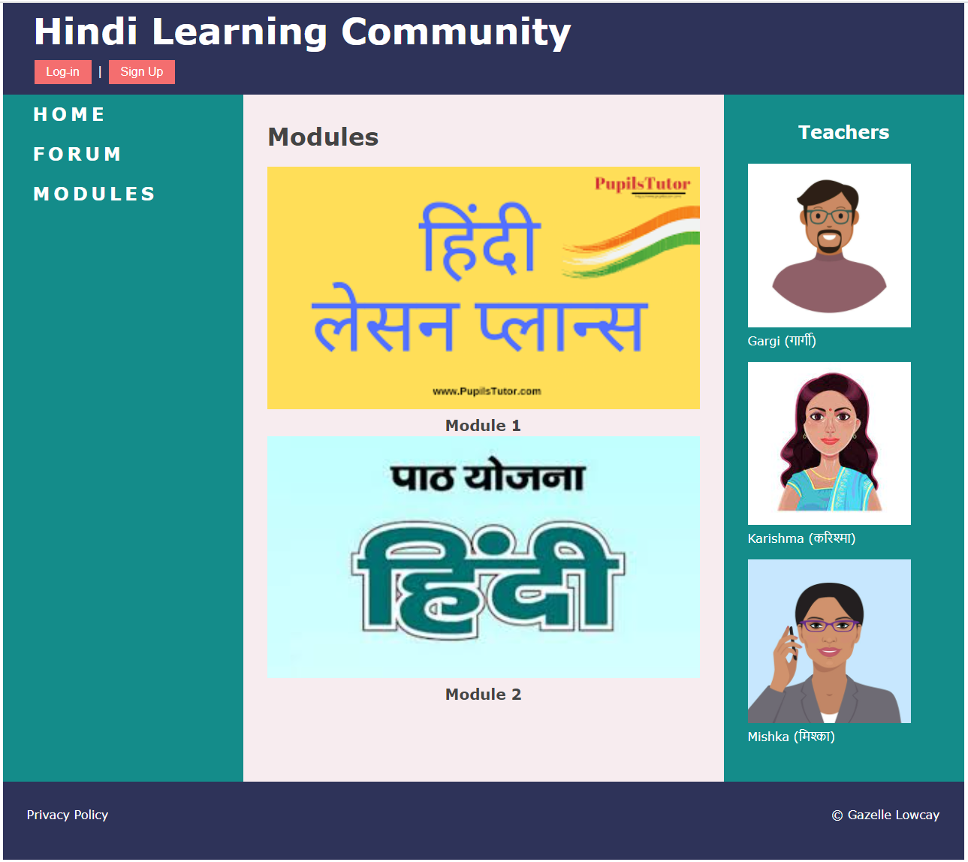
Learn Hindi Community Home Page

Slide 23
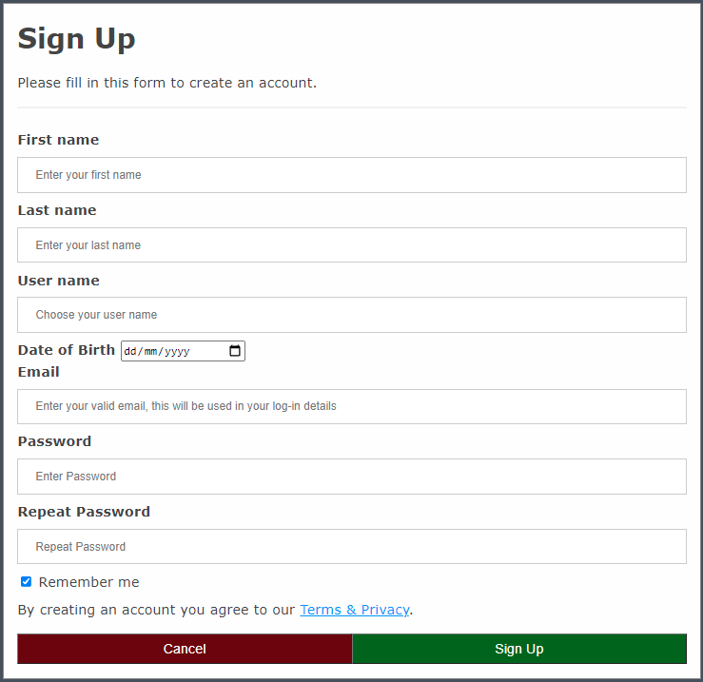
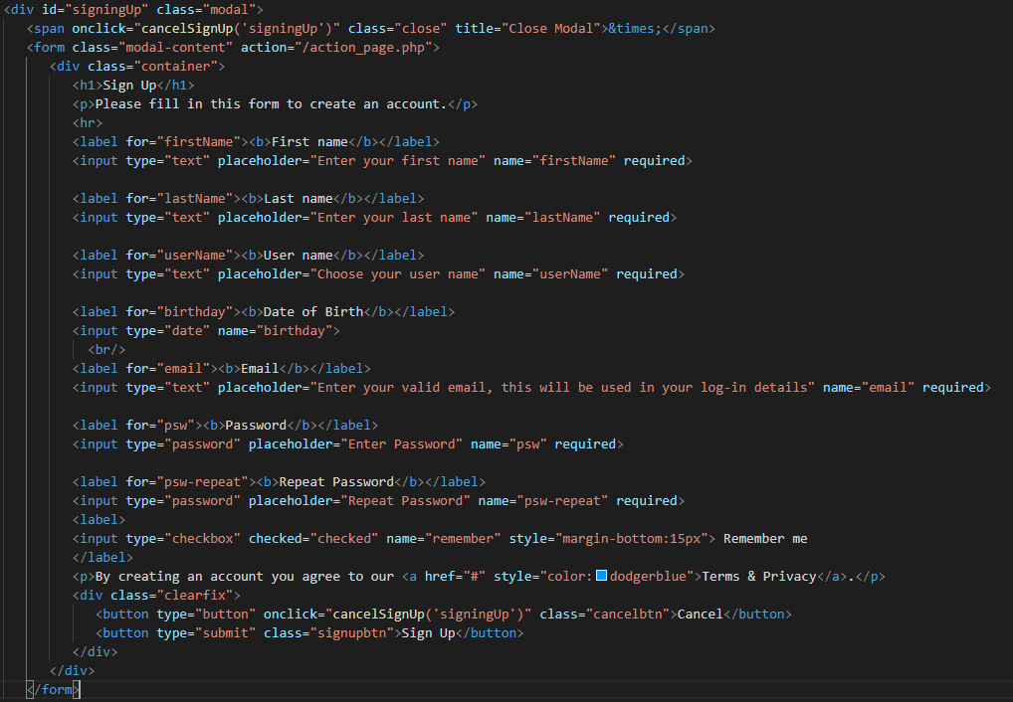
Sing Up Form Source Code (When sign up button is Click)

Slide 24
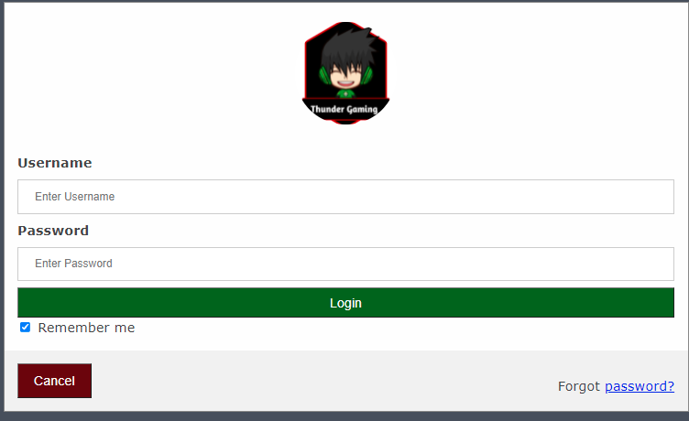
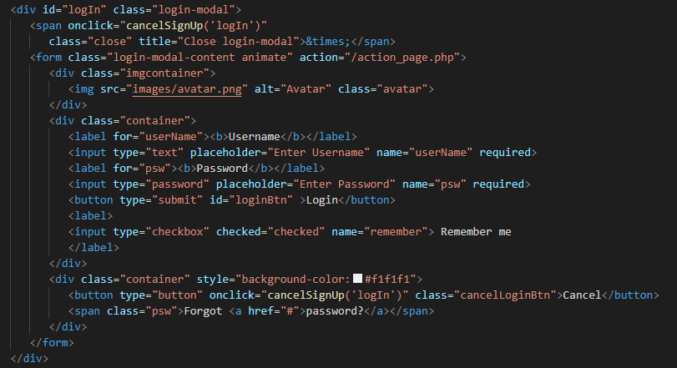
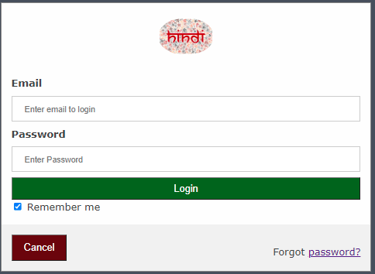
Login Form Source Code (When Log-in button is Click)

Slide 25
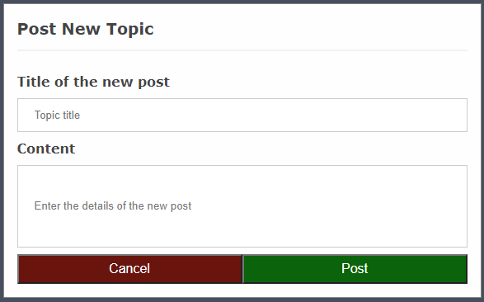
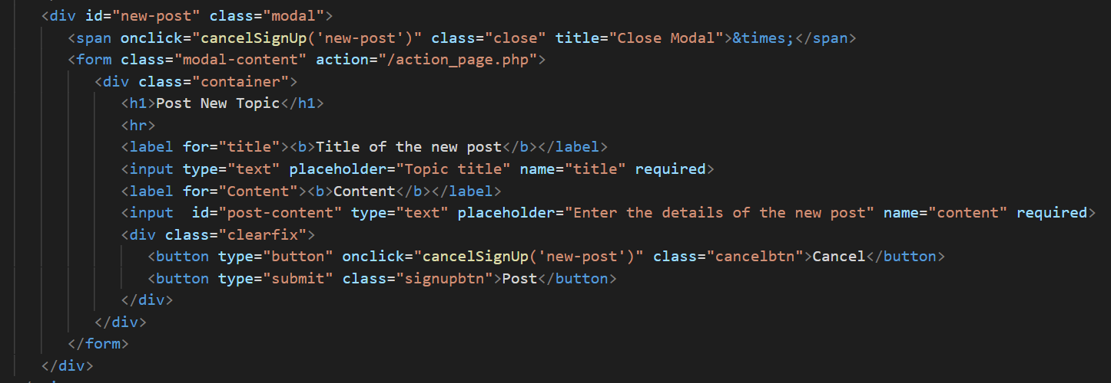
Add New Post Source Code (When Log-in button is Click)

Slide 26

Task: ERD and Database

Slide 27
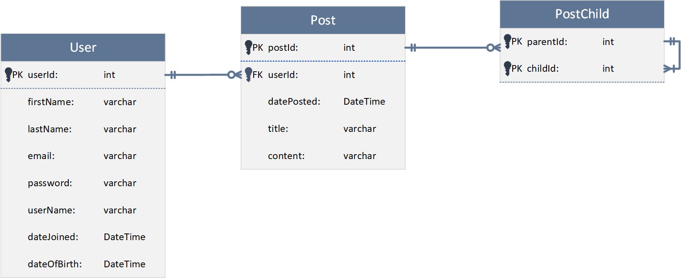
Social Network ERD (For Post Feature)

Slide 28
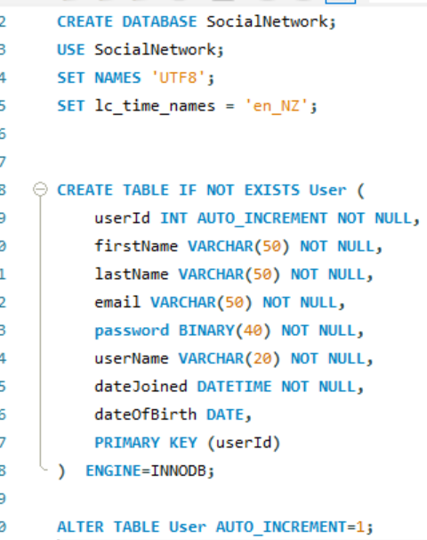
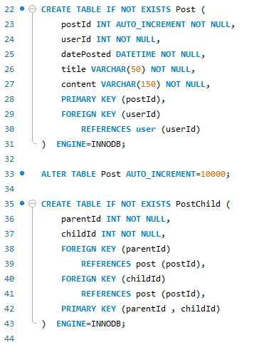
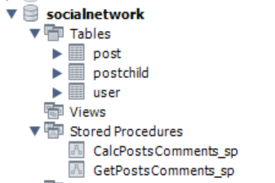
Create Database

Slide 29
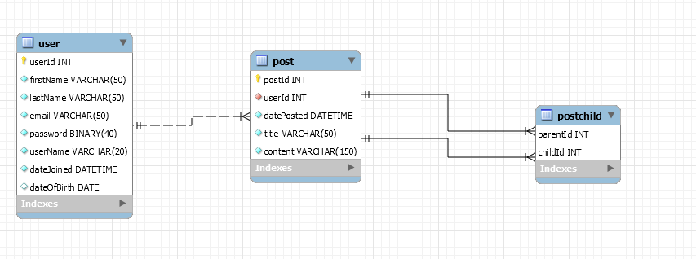
Reverse Engineer

Slide 30
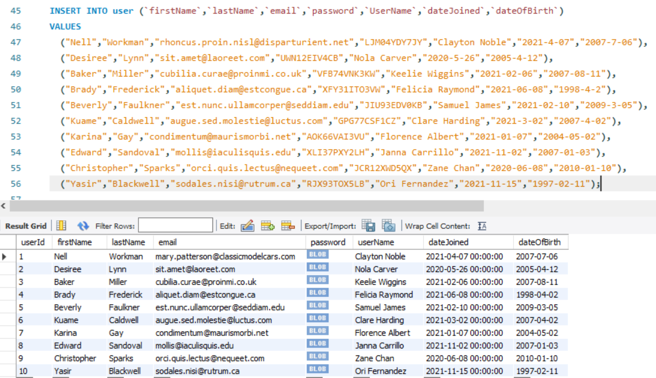
Insert Data (User)

Slide 31
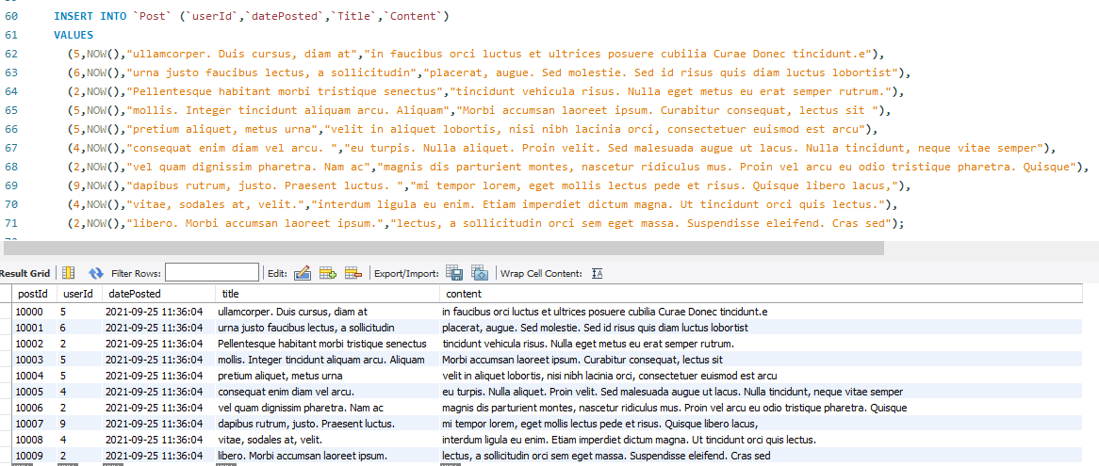
Insert Data (Post)

Slide 32
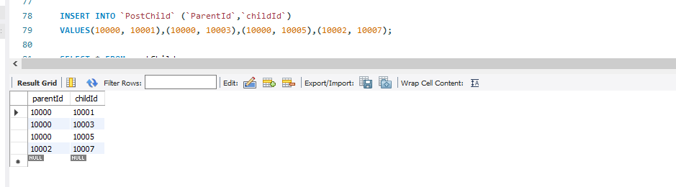
Insert Data (PostChild)

Slide 33
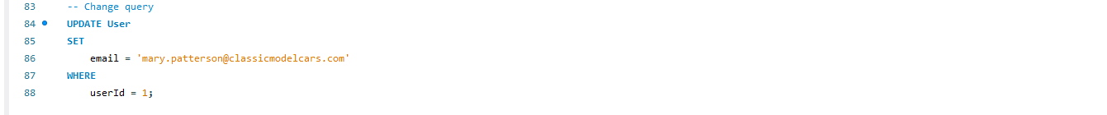
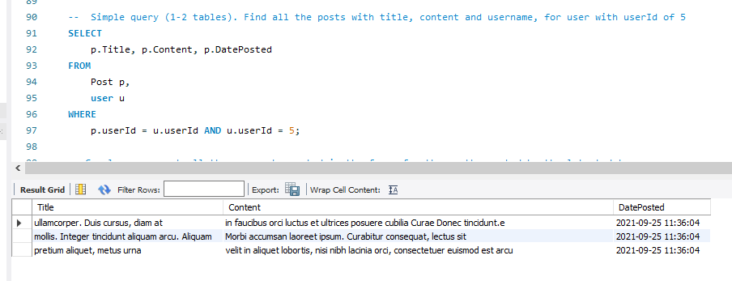
Change Query
Simple Query 1-2 Tables

Slide 34
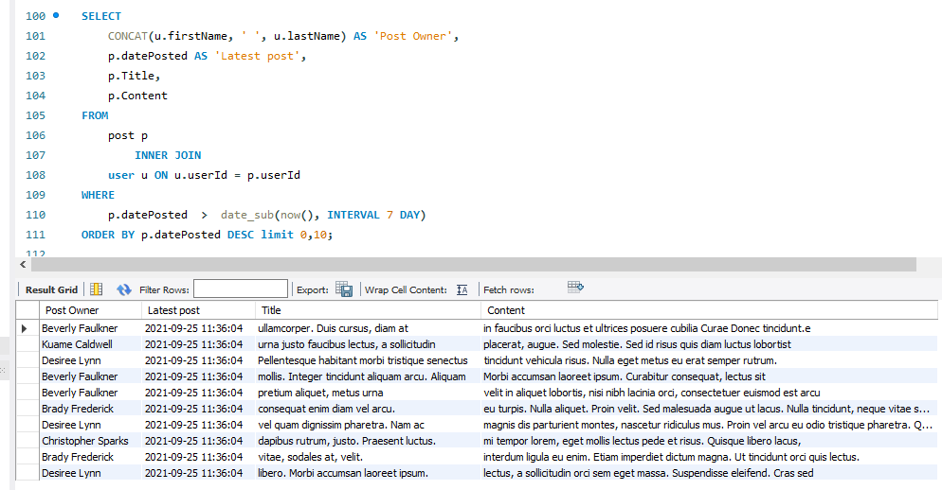
Complex Query #1 - Query the top 10 latest posts in the forum for the last 7 days.

Slide 35
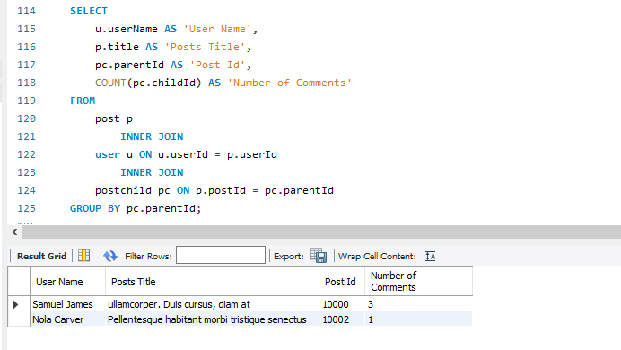
Complex Query #2 - Query to get the most commented posts by calculating the total number of comments for each posts.

Slide 36
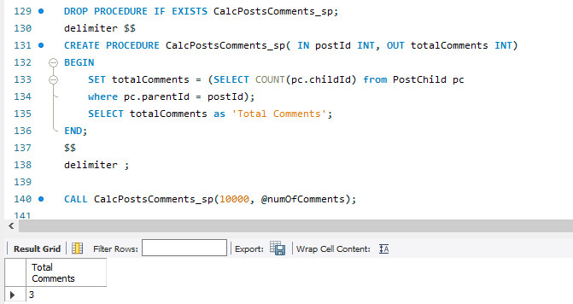
Awesomely Complex Query #1 - Stored procedure to calculate the total number of comments to the given post Id.

Slide 37
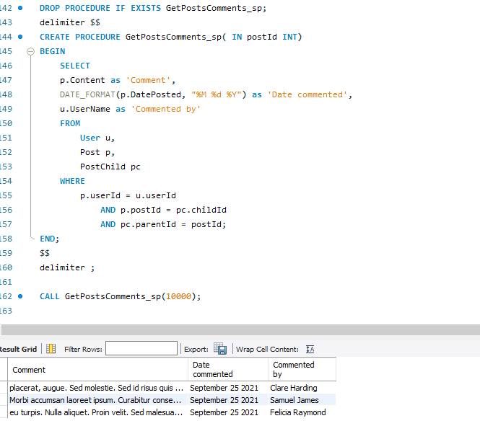
Awesomely Complex Query #2 - Stored procedure that returns all the comments of the provided parent post Id.

Slide 38
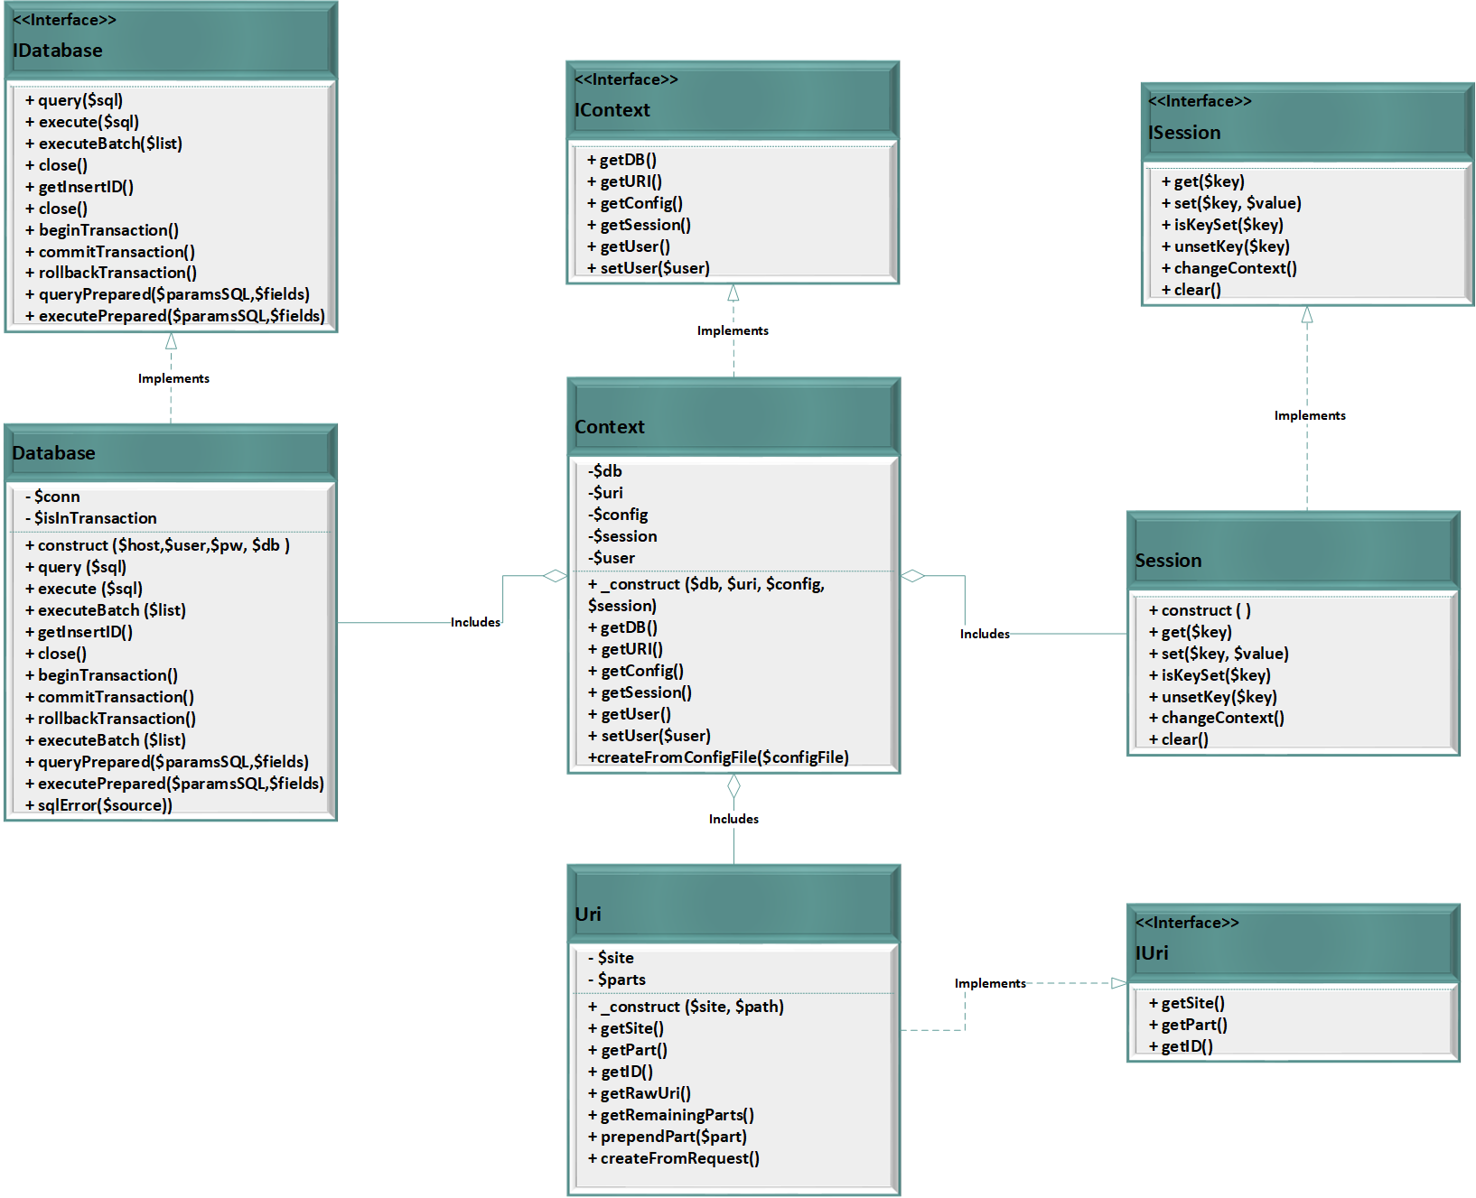
Class Diagram for the Provided Interface

Slide 39
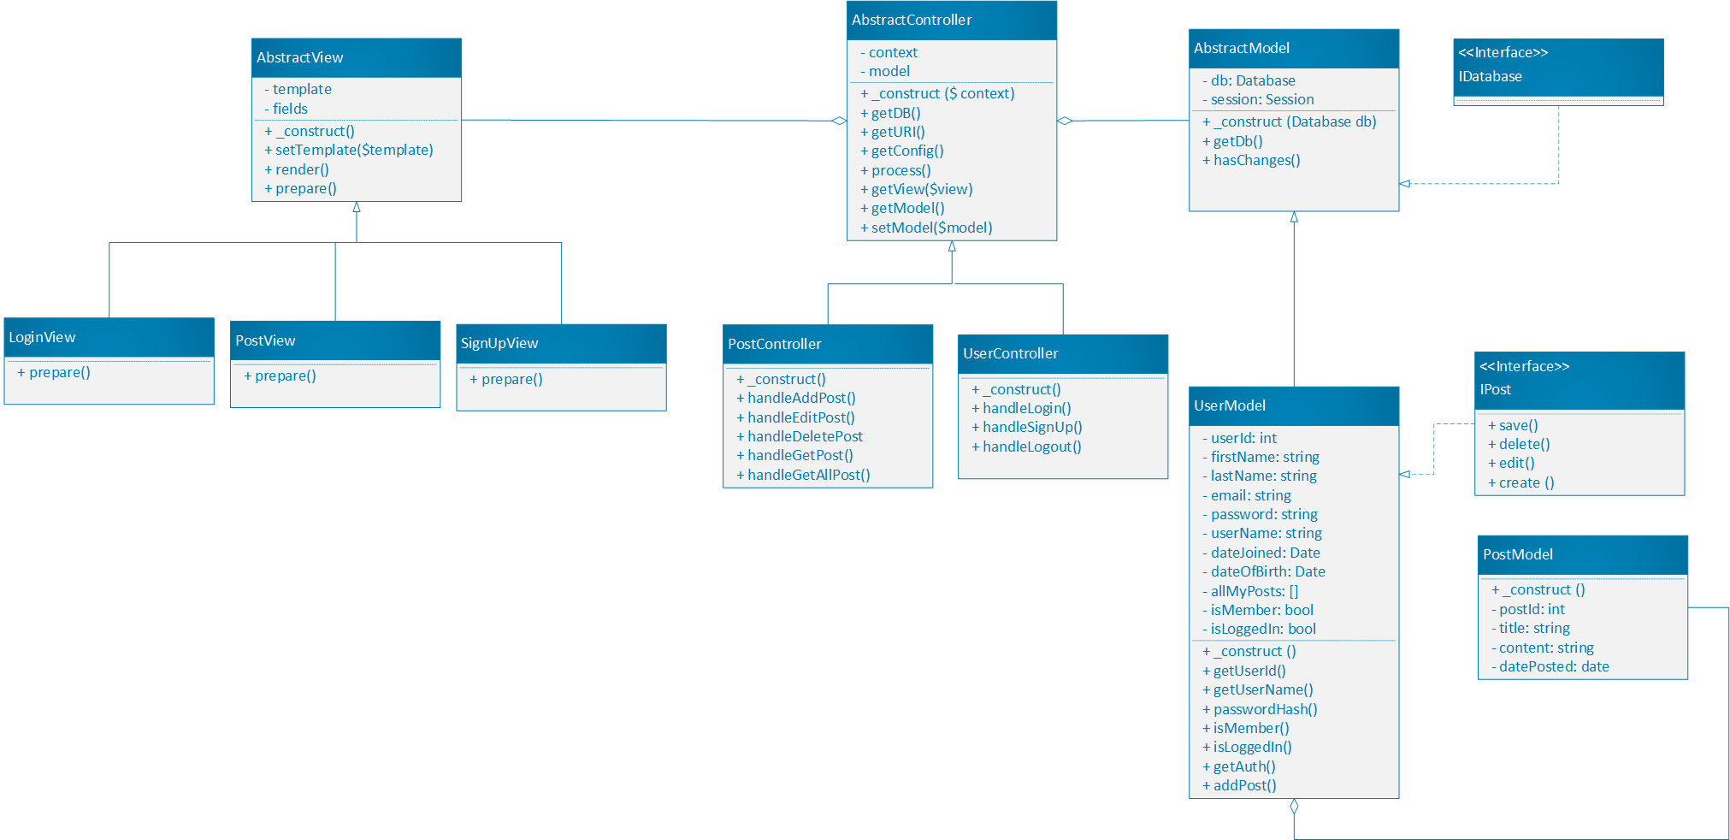
Class Diagram for Post Feature

Slide 40
Summary of Implemented Tasks
Tasks | Implemented
1. Produce TWO Wireframes, one for each community | Yes
2. 3x Behat FEATURE requirements, each for a different user, and each with 2 SCENARIOS | Yes
3. Mock (hard-coded html) forms | Yes
4. ER diagram | Yes
5. Make the database | Yes
6. Insert data | Yes
7. Change query | Yes
8. Simple query (1-2 tables) | Yes
9. Complex query | Yes
10. Awesomely complex query | Yes
11. Class Diagram | Yes

